Slide 1
Azure Event Hub
Dutch Azure Meetup

Slide 2
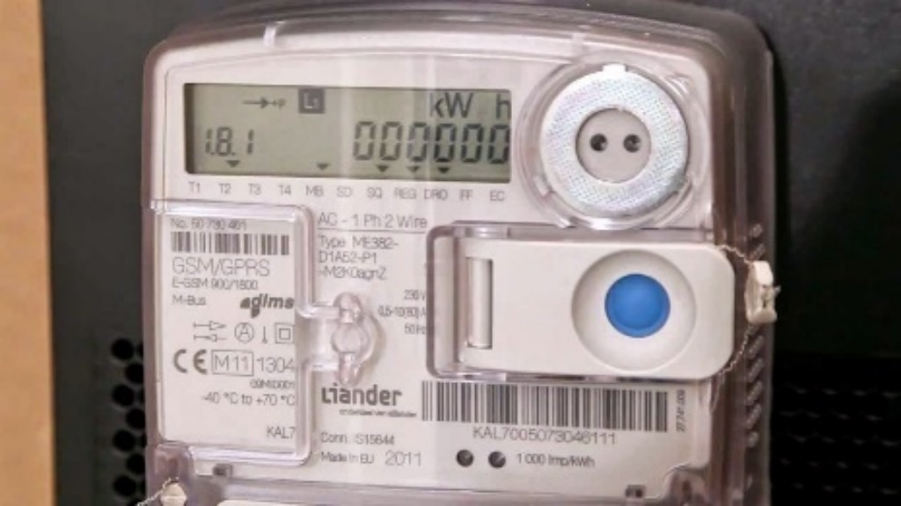

Event Hub - Introduction
Build on Azure Service Bus
Highly scalable publish subscribe service
Massive amounts of data
Very high throughput
Support for millions of publishers
Event Publishers
Azure Event Hub
Event Consumers

Slide 3

In depth
Millions of events
Azure Event Hub
Events
Event Consumer
Event Publishers
1 per partition
Event Publishers
Event Publishers
Event Publishers
Event Publishers
Event Consumer
Event Publishers
Event Publishers
Event Publishers
Consumer Group
Event Publishers
Event Publishers
Event Publishers
Event Publishers
Event Publishers
Event Consumer
Event Publishers
Event Publishers
Partition 1
Event Publishers
Event Publishers
Event Publishers
Event Consumer
Partition 2
Partition 32
Event Consumer
Partition …
Partition 32
Consumer Group
Event Consumer
Event Consumer
# Not changeable
Event Consumer
Offset
Notes:
The choice to use AMQP or HTTPS is specific to the usage scenario. AMQP requires the establishment of a persistent bidirectional socket in addition to transport level security (TLS) or SSL/TLS. This can be a costly operation in terms of network traffic, but only happens at the beginning of an AMQP session. HTTPS has a lower initial overhead, but requires additional SSL overhead for every request. For publishers who frequently publish events, AMQP offers significant performance, latency, and throughput savings.

Slide 4
In depth
10 event hubs in 1 namespace possible
SAS token needed
Azure Event Hub
1 per partition
20 max.
Event Consumer
Event Publishers
Event Publishers
Event Publishers
Event Publishers
Event Publishers
Event Consumer
Event Publishers
Event Publishers
Event Publishers
Consumer Group
Event Publishers
Event Publishers
Event Publishers
Event Publishers
Event Publishers
Event Consumer
Event Publishers
Event Publishers
Partition 1
Event Publishers
Event Publishers
Event Publishers
Event Consumer
Partition 2
Partition 32
Event Consumer
Partition …
Partition 32
Consumer Group
Event Consumer
Event Consumer
Basic: 1 day (at least)
Standard: 1– 7 days
Event Consumer
Notes:
The choice to use AMQP or HTTPS is specific to the usage scenario. AMQP requires the establishment of a persistent bidirectional socket in addition to transport level security (TLS) or SSL/TLS. This can be a costly operation in terms of network traffic, but only happens at the beginning of an AMQP session. HTTPS has a lower initial overhead, but requires additional SSL overhead for every request. For publishers who frequently publish events, AMQP offers significant performance, latency, and throughput savings.

Slide 5
Azure Service Bus vs Event Hub
Service Bus
Message is gone after reading
Competing Consumer Pattern
Multiple receivers to the same queue
Dead-Letter-Queue
Duplicate detection
Message receive confirmation
For Enterprise integration
EventHub
Message stays at least till retention period is expired
Replay messages
Partitioned consumer pattern
Horizontal scaling

Slide 6
Security
Create policies
Primary key
Secondary key
Limited number of 12 policies possible
Policies possible on Namespace & Eventhub level
Default RootManageSharedAccessKey
For whole namespace
With Manage, Send, Listen rights
SAS token = time bound permission for a publisher using a policy
Don’t use this one!
Create a Send only Policy on Event Hub level

Slide 7
Scaling
# TU | # Partitions | Max Total Ingress | Max Ingress per Partition | Max Total Egress | # msgs p/s ingress (5 KB)
1 | 2 | 1.0 MB/s | 0.5 MB/s | 2 MB/s | 204
2 | 2 | 2.0 MB/s | 1.0 MB/s | 4 MB/s | 408
1 | 10 | 1 MB/s | 0.1 MB/s | 2 MB/s | 204
5 | 10 | 5 MB/s | 0.5 MB/s | 10 MB/s | 1024
10 | 10 | 10 MB/s | 1.0 MB/s | 20 MB/s | 2048
20 | 10 | 10 MB/s | 1.0 MB/s | 20 MB/s | 2048
20 | 20 | 20 MB/s | 1.0 MB/s | 40 MB/s | 4048
Partitions are free!
HTTP is free!
# TU’s: 1-20
AMQP Connections: Basic: 100 Standard: 1000 Max 5000
Throughput Unit
Event Publishers
Azure Event Hub
Event Consumers
Max 84 GB
Event: Max 256 KB
Max 1 MB or 1000 events per second
Max 2 MB per second
Per Partition
>? ServerBusyException
Notes:
https://alexandrebrisebois.wordpress.com/2014/07/18/getting-acquainted-with-azure-service-bus-event-hubs/
Miljoenen gebeurtenissen per seconde streamen
Azure Event Hubs is een uiterst schaalbare publicatie- en aanmeldingsservice die miljoenen gebeurtenissen per seconden kan verwerken en ze naar meerdere toepassingen kan streamen. Hierdoor kunt u enorme hoeveelheden gegevens verwerken en analyseren die door uw verbonden apparaten en toepassingen worden geproduceerd. Zodra de gegevens door Event Hubs zijn verzameld, kunt u ze transformeren en opslaan met elke gewenste realtime analyseprovider of met batching-/opslagadapters.

Slide 8
Event Hub Scaling tiers
Basic
1 consumergroup
100 connections included
Not more connections possible
1 day retention included
Standard
1-20 consumergroups
1000 connections included
More connections possible
1 day retention included till 7 days possible
Publisher policy possible

Slide 9
Event Hub Pricing
Pay per hour
1 Event max 64 kB
Basic
€ 0,0236 per million events
€ 9,41 per TU per month
Standard
€ 0,0236 per million events
€ 18,82 per TU per month
€ 50,19 per TU per month with archive
Extra costs: Connections, Storage
Scenario | Basic | Standard
1 TU 100 mln events < 64 KB | 1*9,41 9,41 100 mln * 0,0236 = 2,36 11,77 | 1*18,82 18,82 100 mln * 0,0236 = 2,36 21,18
20 TU 100 bilj events < 64 KB | - | 20*18,82 376,40 1 bilj * 0,0236 23,60 400,00

Slide 10
Hands-on: Event Hub

Slide 11
Hands-on: Event Hub
To receive data from thermostats: Create an Azure Event Hub
To mimic thermostats: Start the thermostat generator to send events to the Event Hub.
http://xpir.it/azurebd1

